Slide 1

Online Job Portal
Team Members
Parth Awasthi – Team Lead
Md Ashraf Ali
Sai Kiran
Mohd Haroon
Mentor :
Shaikh Immamudin

Slide 2
INTRODUCTION
Welcome to the Job Portal, a web-based solution designed to connect job seekers with employers easily.
This platform simplifies job searching and recruitment, allowing job seekers to browse listings and apply, while employers can post jobs and manage applications.
In this presentation, we will walk you through the key features and how the system enhances efficiency for both job seekers and employers.

Slide 3
TECHNOLOGIES
Frontend : React , JavaScript, CSS(localhost 3000)
Backend : SpringBoot 3.0
Webserver : Apache Tomcat (locally on 8080)
Database : MySQL 8.0 (localhost 3306)
IDE : VsCode
API Testing : Postman

Slide 4
SYSTEM REQUIREMENT
Windows 10, macOS 10.13+, or Linux
Mobile: iOS 13+ or Android 8+
CPU: Dual-core processor (e.g., Intel i3, Apple A10, or equivalent)
RAM: 4 GB (PC/tablets), 2 GB (smartphones)
Storage: 500 MB free space
Internet: Stable broadband or 4G/5G connection

Slide 5

Pages in our Web Application
Landing Page
Login & Register
Getting started
Option for login - Register
Take input for Applicant demographics.
Input field validation
Password length validation
Job Openings
Admin Dashboard
Apply for available jobs
Enter your details based on the job
Upload your CV
List of All applicants
Puts up new Job Descriptions.

Slide 6

Getting Started
Candidate Profiling
Waiting period
Enter your details and Register to create profile
Wait to hear back from the Employer
1
2
3
Job Matching
Apply for relevant jobs from job listings

Slide 7
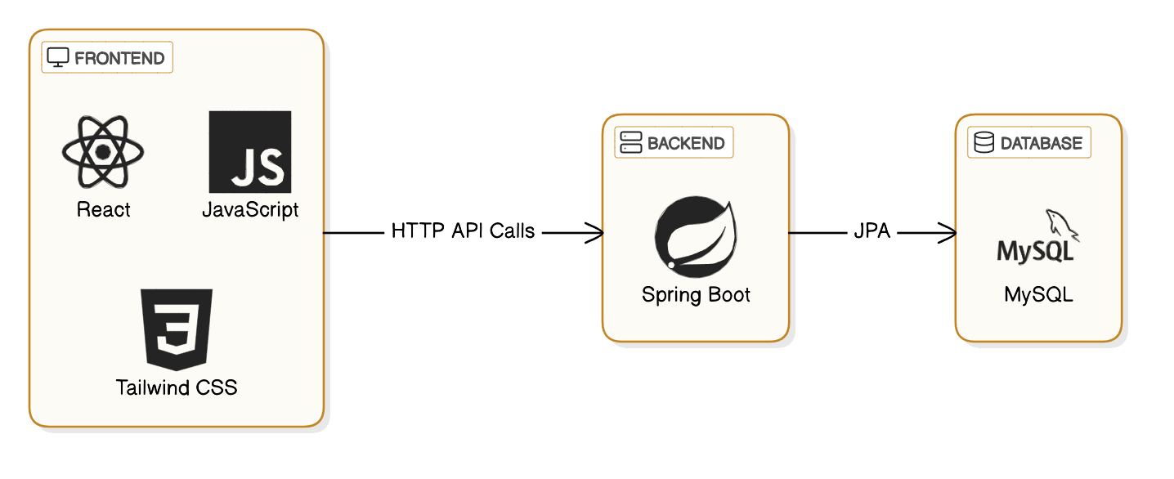
TECHNOLOGY STACK

Slide 8
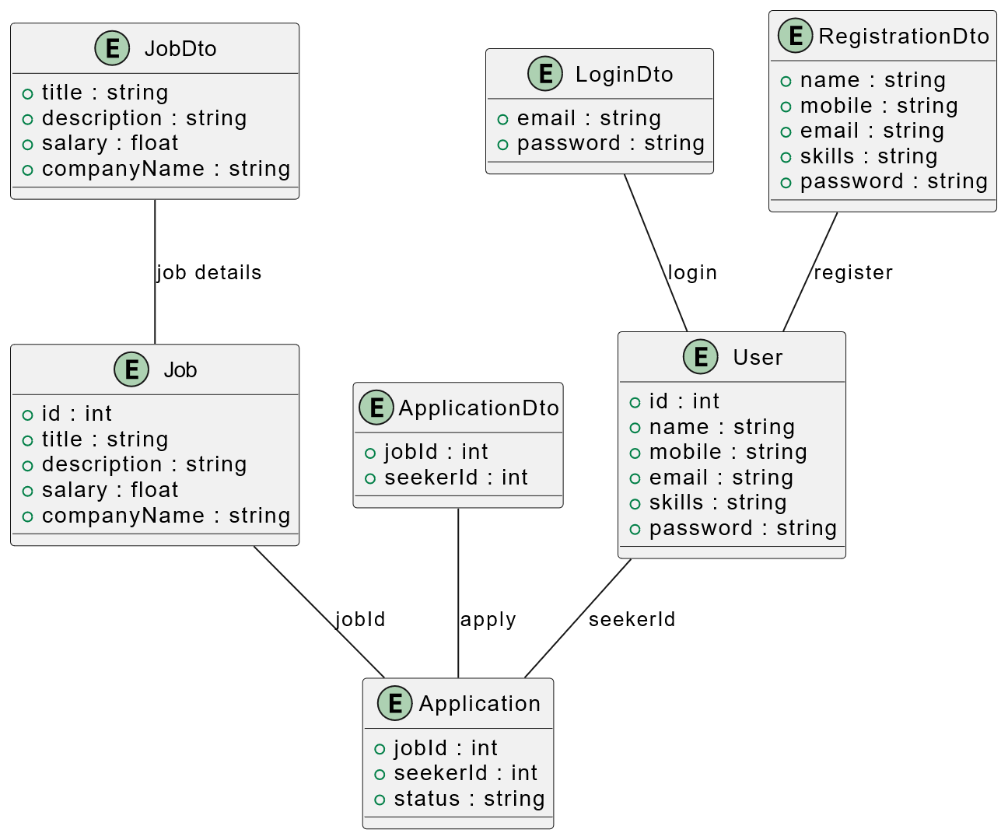
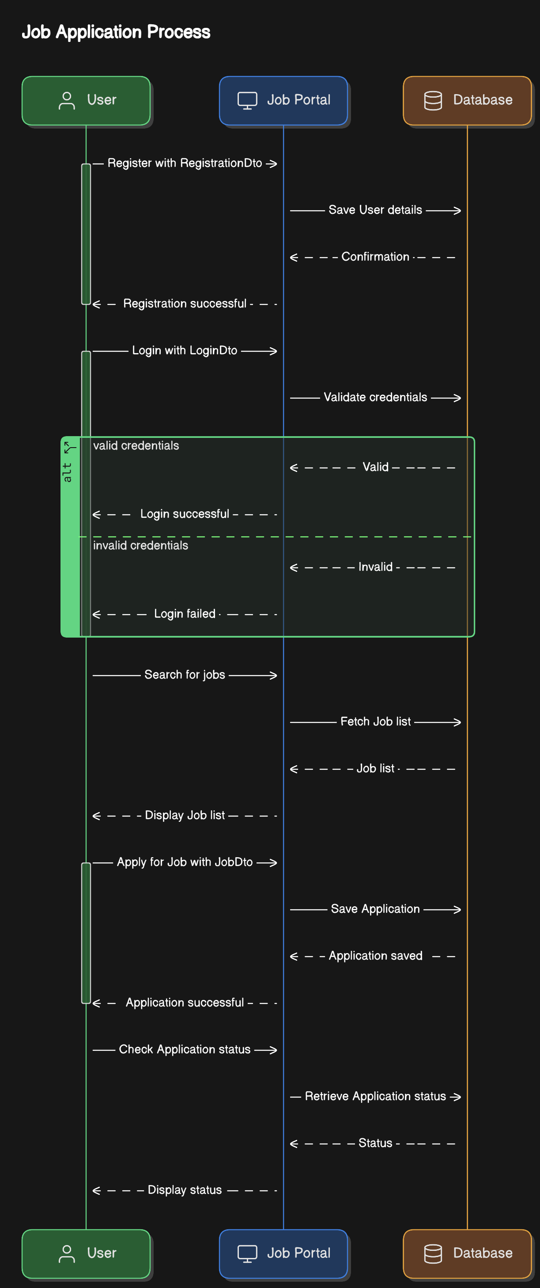
UML diagram
CLASS
SEQUENCE

Slide 9




Key Milestones for the Online Job Portal Project
User Authentication and Registration
1
Implement the user login mechanism on the online job portal platform.
Job Availability Management
2
Develop interface for job availability information and backend functionality.
Appointment Scheduling Interface
3
Implement functionality for users to select Job, preferred time slots, and reasons for the appointment.
Appointment Management
4
Develop an interface for Job and Job seekers to view and manage appointments.
The key milestones for the online job portal project include the initial product launch, integration of AI-powered job matching, the release of the employer dashboard, and ongoing platform optimization based on user feedback and data analysis.

